Slide 1




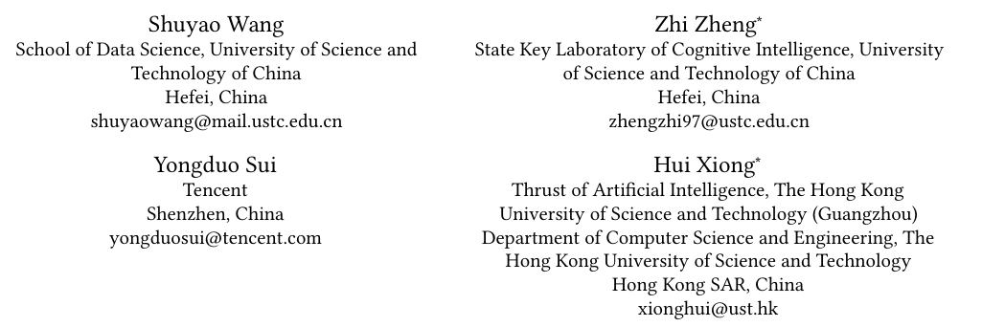





ATAI
Advanced Technique of Artificial Intelligence
ATAI
ChongqingUniversity _{AdvancedTechniqueof}
of Technology Artificial Intelligence
Chongqing University of Technology
Chongqing University ^{ATAI}
_{of Technology} Advanced Techniqueof
Artificial Intelligence
Chongqing University of Technology
Chongqing University of Technology
Unleashing the Power of Large Language Model
for Denoising Recommendation
code:https://github.com/shuyao-wang/LLaRD
—— WWW ’25
Reported by Jinfei Chen
1

Slide 2
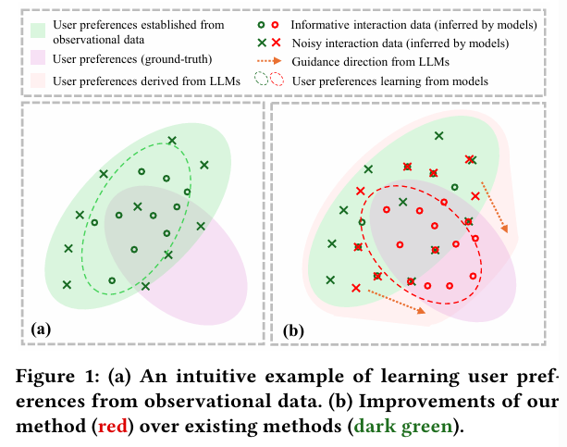
ATAI
Advanced Technique of
Artificial Intelligence
ATAI
ChongqingUniversity _{AdvancedTechniqueof}
of Technology Artificial Intelligence
Chongqing University of Technology
Motivation
Existing denoising studies involve incorporating auxiliary information or learning strategies from interaction data. However, they struggle with the inherent limitations of external knowledge and interaction data, as well as the non-universality of certain predefined assumptions, hindering accurate noise identif ication.

Slide 3
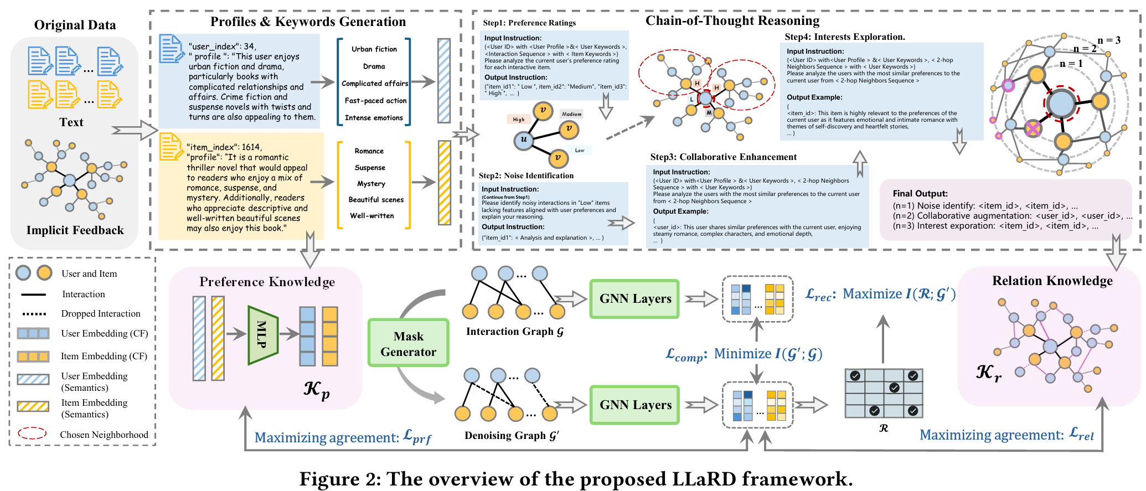
ATAI
Advanced Technique of
Artificial Intelligence
ATAI
ChongqingUniversity _{AdvancedTechniqueof}
of Technology Artificial Intelligence
Chongqing University of Technology
Overview

Slide 4
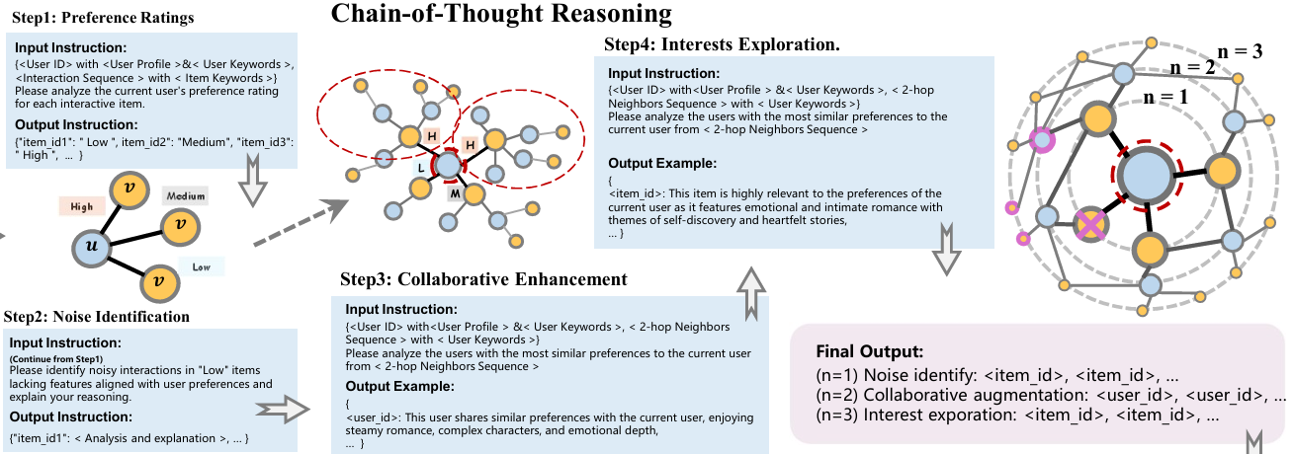
ATAI
Advanced Technique of
Artificial Intelligence
ATAI
ChongqingUniversity _{AdvancedTechniqueof}
of Technology Artificial Intelligence
Chongqing University of Technology
Method

Slide 5
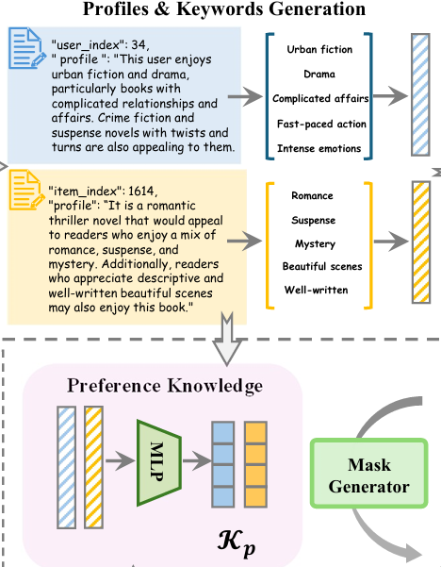

ATAI
Advanced Technique of
Artificial Intelligence
ATAI
ChongqingUniversity _{AdvancedTechniqueof}
of Technology Artificial Intelligence
Chongqing University of Technology
Method

Slide 6

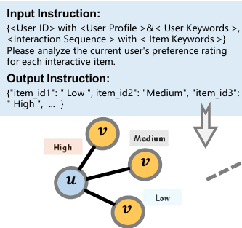

ATAI
Advanced Technique of
Artificial Intelligence
ATAI
ChongqingUniversity _{AdvancedTechniqueof}
of Technology Artificial Intelligence
Chongqing University of Technology
Method

Slide 7
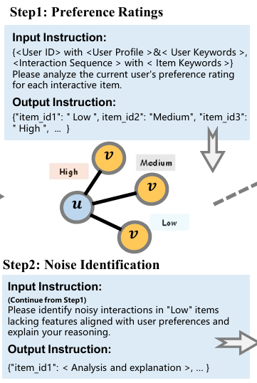
ATAI
Advanced Technique of
Artificial Intelligence
ATAI
ChongqingUniversity _{AdvancedTechniqueof}
of Technology Artificial Intelligence
Chongqing University of Technology
Method

Slide 8

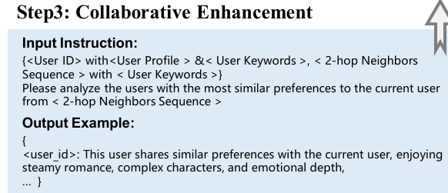


ATAI
Advanced Technique of
Artificial Intelligence
ATAI
ChongqingUniversity _{AdvancedTechniqueof}
of Technology Artificial Intelligence
Chongqing University of Technology
Experiments

Slide 9

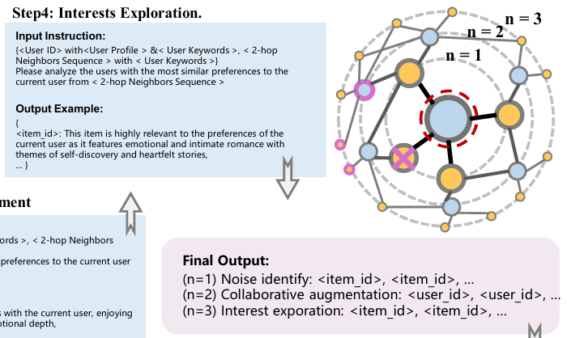
ATAI
Advanced Technique of
Artificial Intelligence
ATAI
ChongqingUniversity _{AdvancedTechniqueof}
of Technology Artificial Intelligence
Chongqing University of Technology
Experiments

Slide 10
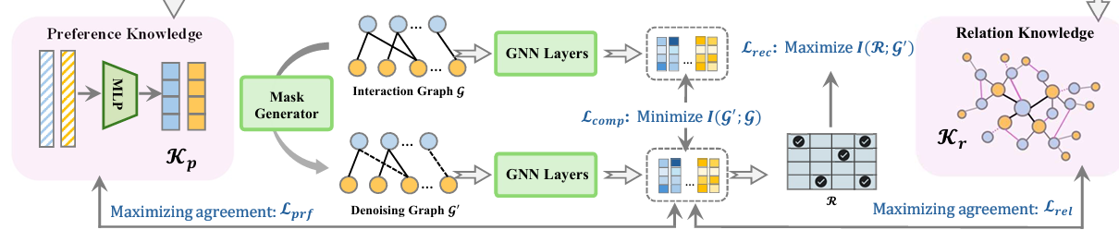




ATAI
Advanced Technique of
Artificial Intelligence
ATAI
ChongqingUniversity _{AdvancedTechniqueof}
of Technology Artificial Intelligence
Chongqing University of Technology
Experiments

Slide 11
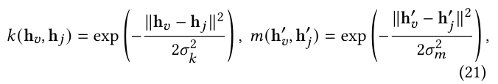


ATAI
Advanced Technique of
Artificial Intelligence
ATAI
ChongqingUniversity _{AdvancedTechniqueof}
of Technology Artificial Intelligence
Chongqing University of Technology
Experiments

Slide 12
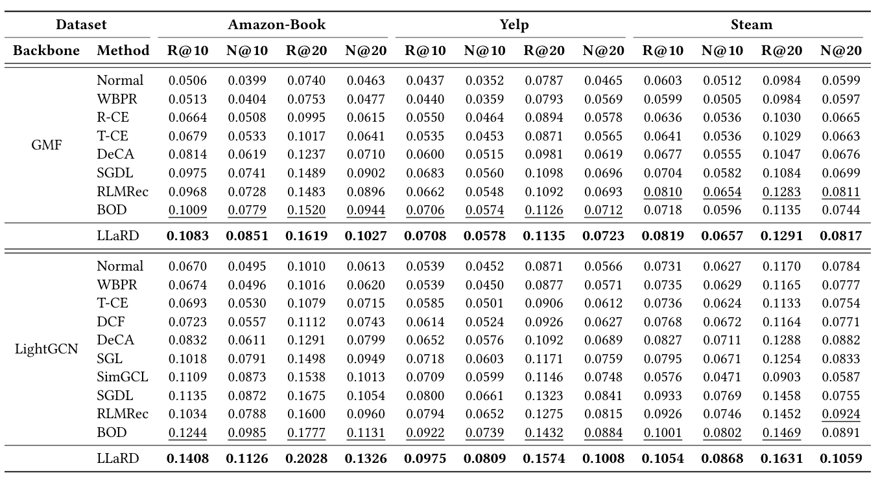
ATAI
Advanced Technique of
Artificial Intelligence
ATAI
ChongqingUniversity _{AdvancedTechniqueof}
of Technology Artificial Intelligence
Chongqing University of Technology
Experiments

Slide 13
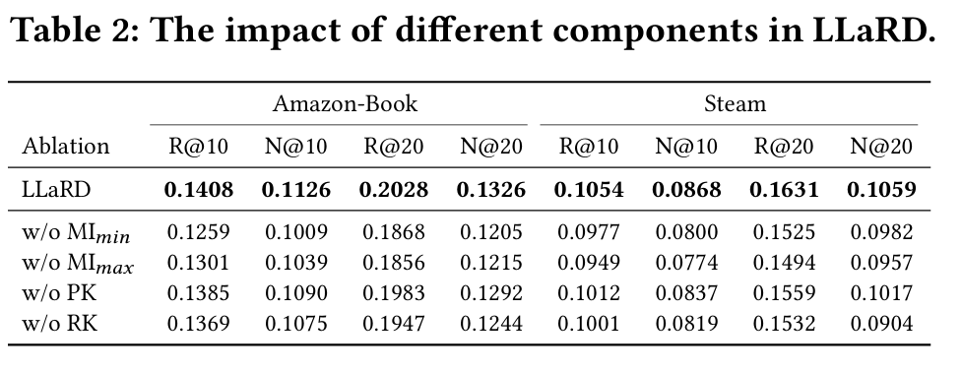
ATAI
Advanced Technique of
Artificial Intelligence
ATAI
ChongqingUniversity _{AdvancedTechniqueof}
of Technology Artificial Intelligence
Chongqing University of Technology
Experiments

Slide 14
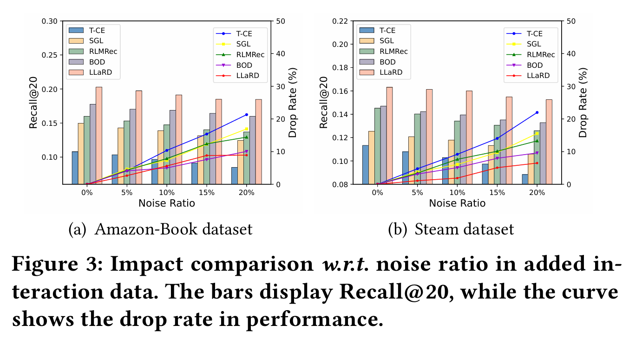
ATAI
Advanced Technique of
Artificial Intelligence
ATAI
ChongqingUniversity _{AdvancedTechniqueof}
of Technology Artificial Intelligence
Chongqing University of Technology
Experiments

Slide 15
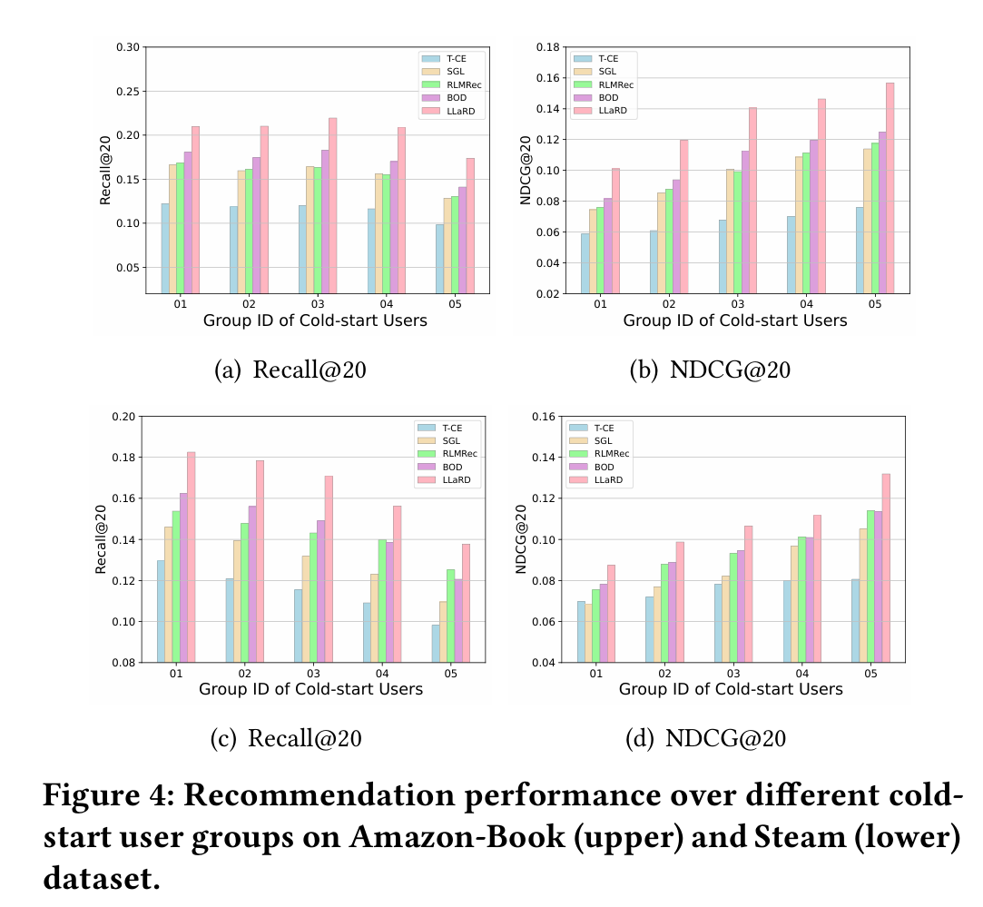
ATAI
Advanced Technique of
Artificial Intelligence
ATAI
ChongqingUniversity _{AdvancedTechniqueof}
of Technology Artificial Intelligence
Chongqing University of Technology
Experiments

Slide 16


ATAI
Advanced Technique of
Artificial Intelligence
ATAI
ChongqingUniversity _{AdvancedTechniqueof}
of Technology Artificial Intelligence
Chongqing University of Technology
Thanks!

